Slide 1
How to overcome social theory´s imbedded censorship
Violence Sociology jan 2021 António Pedro Dores

Slide 2
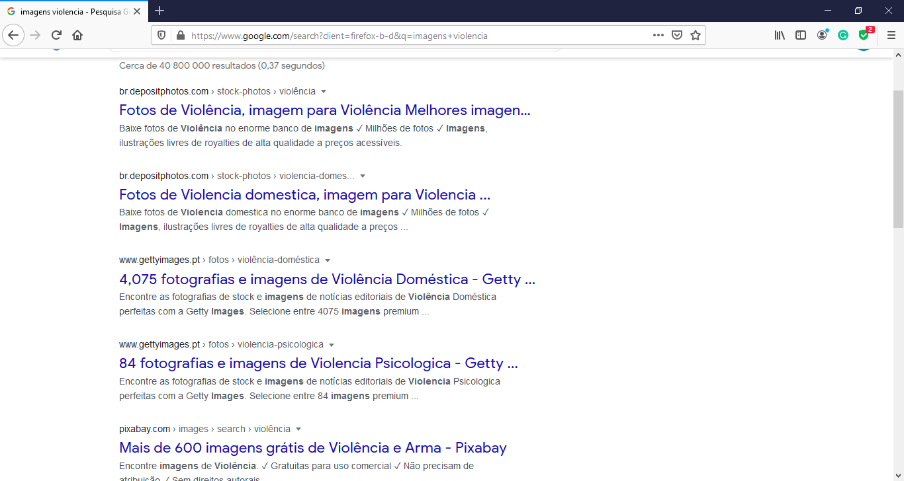

Slide 4
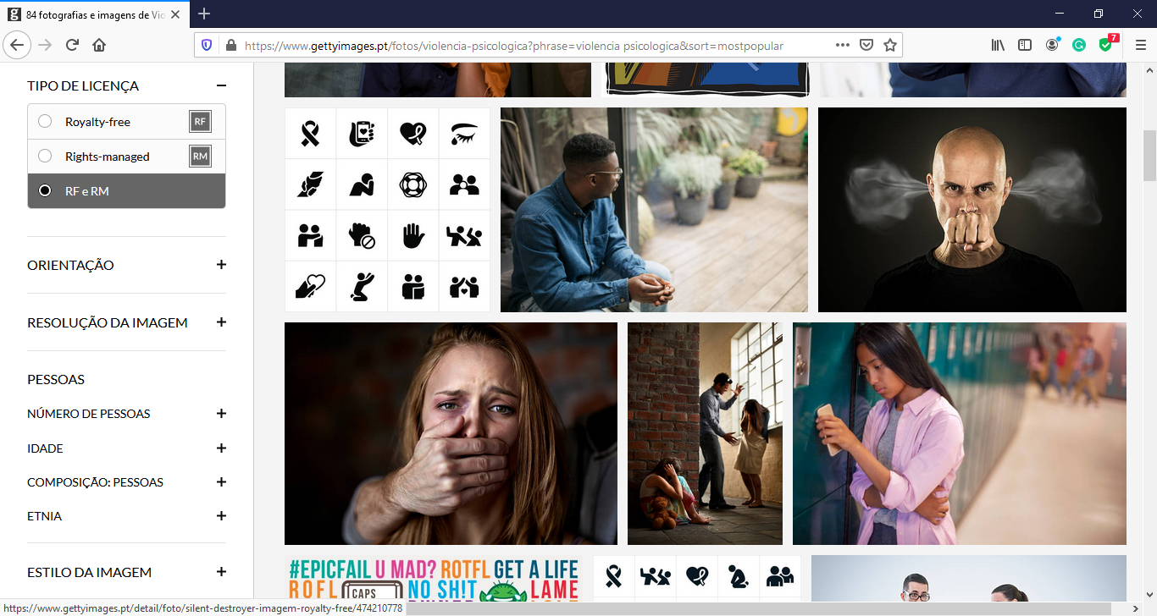

Slide 5
What is missing?
School violence (inter students bullying; teacher students bullying; program planning; pair pressure to convey to professional ideology)
Sport violence (fan´s excitement, hooligans, competion, corruption)
Work violence (harassement, wage, working time, business secracy)
Cold weather violence
Social isolation violence
Health care violence
State violence ….

Slide 6
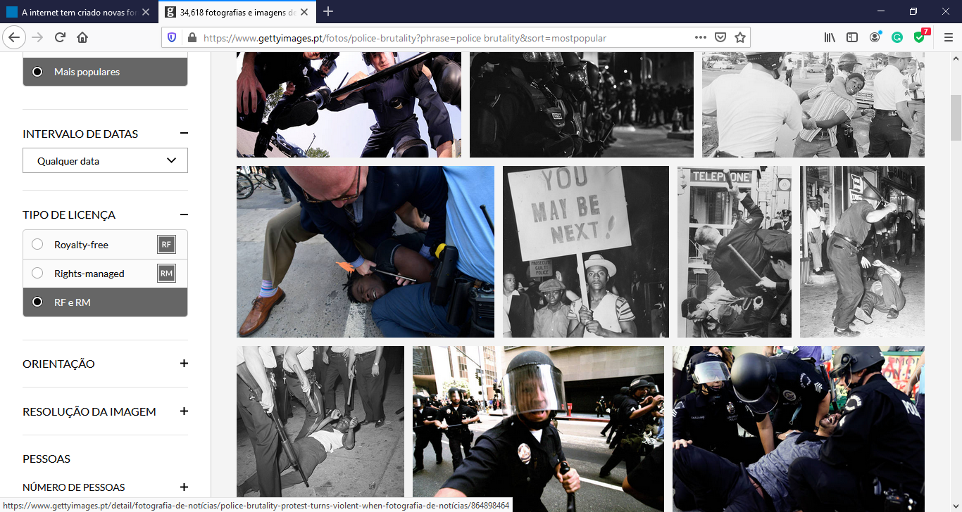

Slide 7
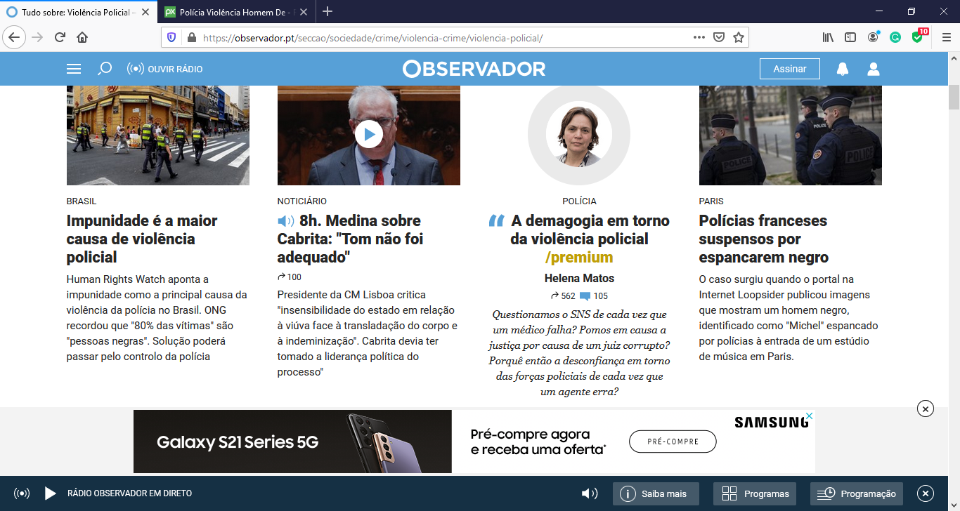

Slide 8
Violence sociological concepts
Domestic violence; Police violence – interpersonal violence
Collins (“the rare violents”)
Structural violence: school, labor, class, urban, sport, war
Wieviorka (“In my point of view, violence is the failure, the impotence ou reversal of the Subject (…)” within his/her social frame; cruelty)
Pandemic violence
Structurant violence: care, identity (hiden power)
Reemtsma: (“reduction to the body”)

Slide 9
Planetary turn
Ulrich Beck´s Risk Society
Latour´s ANT (actor network theory)
John Urry´s Mobilities
Damasios´s homeostasis
Bronislaw Szerszynski´s Globalization ecosociology
Michael Kuhn´s world critic of globalizing social theories
Jim Schofield´s lake of Physics of the universal substract
Social theory lake of care analysis

Slide 10
Conclusions and starting points
Missleading controversy about everyday vs structural violence
Censorship is hiden by this (Imperial) ideological distraction (class struggle; state-market opposition; nationalities; gender: concealing discriminations - intersectionalism)
Mankind is an imbedded part of cosmic evolution
Violence is not human creation, even the nuclear weapon
Social Science should merge with Science
Violence is reduction to the body (human, earthly, cosmic) side of evolution, both micro (like epidemic) and macro (black whole)

