Slide 1
Violence as anomie
From the definition of Reemtsma
António Pedro Dores, 2017 March

Slide 2
Index
Types of society and violence
The production of bio-social levels of reality, and evolving
States of mind as social atom – diversity and limits; violence and cohesion
Sociological pragmatics facing transformation times and social sciences

Slide 3
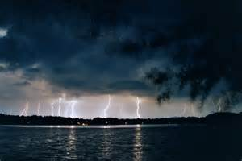
Corporative coercive society
Durkheim / macro weberian Wieviorka
Gains:
Potencialities of social actions

Slide 4
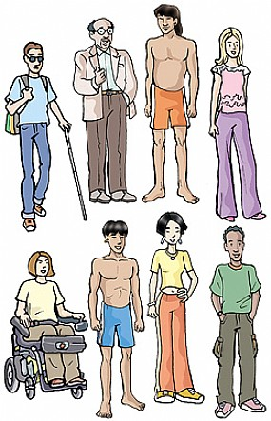
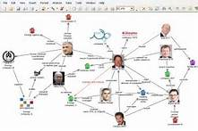
Liberal virtual society
Weber / micro
Durkheimian Collins
Gains:
Sources of energy of social action

Slide 5
Human recursivity
Aspirations/positions
Identities
Expectations
Resources/potencialities

Slide 6
Teoria Loïc Wacquant
Neo-liberalismo
STATE
Left hand
“workfare”
Right hand
“prisonfare”
Prison
CITY
Hiper-ghetto
Anti ghetto
Punishing the poor
Deadly symbiosis
CLASS
(market)
RACE
(ethnicity)
Urban outcast
(BODY)
Body and soul
Marginality, ethnicity and penality in the neoliberal city, 2014

Slide 7
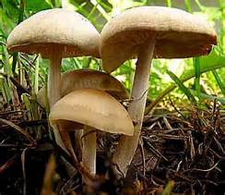
Unstable society
Gains:
Indispensability, instead of
potencialities, of social action
Sources of bio-social energy
of social action
Evolution, emergency, levels
Biology and spirituality
Violence and ideology

Slide 8
The production of bio-social levels of reality, and evolving

Slide 9
Social human nature
Doing
Voicing
Being

Slide 10
Empirical levels of reality
Normative power
Social power
Psycho-biological power

Slide 11
Social organization apparent principal
Elitisme / desire
Misogynie / afective
Dissimulation / cognitive
Differentiation
Institutionalization

Slide 12
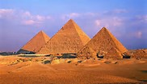
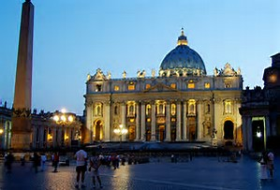
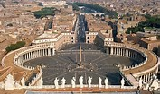

Slide 13
Social organization real principal
Elitism / desire
Misogynie / afective
Dissimulation / cognitive
Misogynie / domestic
Dissimulation / humiliation
Elitism / sacrificial

Slide 14
Modes of organization
Oligarchy
Neo-liberalism
Class struggle
Post-imperial
Populism
Produtivist / rentist
Democratization
Produtivist / rentist

Slide 15
States of mind

Slide 16
States of mind as power
To forbid
Submission
Marginal

Slide 17
States of mind as biopolitics
Violence
Humor
Intimacy

Slide 18
Social integration and exclusion
Mirror

Slide 19
Imaginative future unite
ABOLICIONIST DEMOCRACY
Sovereignty
Legitimacy
Diverse and free Interests
Moral judgments
Equality for all
Social
Constructed
Reality
levels
CENTRIFUGAL SCIENCE
ANTI-EXTRATIVISM
Corruption
Dynamism
Impunity
Privileges
TRANSFORMATIVE JUSTICE
Depression
Hope
CITIZEN INCOME

Slide 20
Sociological strategy
for social sciences

Slide 21
Return to the scientific path for social theories
 | Humanities | Social sciences | Sciences
Marx | x |  | x
Durkheim |  | x | x
Weber | x | x
Consultar post

Slide 22
Durkheim/Marx aliance
Societies endure thought and fast transformations under change resilient regimes
Societies emerge from (biological and evolutionary) motors
Societies are over-determined by normative ambiences (doctrines/will)
Technological progress results also from bio-social evolution

Slide 23
Modernization and Social Dynamics
Emancipatory cycle
Solidarity cycle
racionalização
racionalização
reclamação direitos
reclamação direitos
Controlo
Exclusão
fechamento
fechamento
criminalização
criminalização
revolução
revolução
institucionalização
institucionalização
Justiça social

Slide 24
Social metodologies and dynamics
Solidarity cycle
Emancipatory cycle
observation
inquiry
normas
normas
Emergências ideológicas
Emergências ideológicas
Classificações regulamentares
Habitus
Estratégias corporativas
Estratégias corporativas
verdade oficial
verdade oficial
subordinação
subordinação
submissão
submissão
Violência estruturante
genealogy

Slide 25
Evolution of the organization
Instinct | Basic needs | Sociabilities | Civilization
At once | Survival | Learning | Dissimulation
Sexual | Reprodution | Control | Misogynie
Social | Adaptation | Solidarity | Elitism
Linguage/coordination
Violence/ideology
Look for:
SOLUTION
GUILT
Trust prodution
Privilege production
Emancipatory Cycle
Solidary Cycle (fidelity or submition)

Slide 26
The end
http://iscte.pt/~apad
http://iscte.pt/~apad/estesp
http://iscte.pt/~apad/estesp/trilogia.htm

