Slide 1
The limits of political economy in understanding criminalization
António Pedro Dores
September 2016

Slide 2
Problem
The cognitive contradiction between the legal justification for the criminal/penal system as defender of society and the lack of a causal statistical relation between crime and punishment

Slide 3
Epistemic obstacles to understanding criminalization
Explaining too much, e.g. court decisions or crime typology or political economy
Explaining nothing, e.g. crime news or forensic psychology or conspiracy theory

Slide 4
Missed targets and taboos
Political economy is shoots wide, it is misleading and incomplete to address criminalization
Conspiracies are a taboo subject; conspiracy theory is a vacuum cleaner of ideas on discrimination and crime

Slide 5
Modern differentiation by liberal state
Politics | is not | Society
Economy | is not | (Policy)
Political economy | is | Exclusive ideology
Conspiracies | is | Perverse human nature

Slide 6
Criminalization
Satisfying and controlling revenge instincts
Institutional regime of justification for what is socially unacceptable – crime caused by individuals
Regime of justification to support domination – controlling conspiracies by legal, criminal and intelligence institutions

Slide 7
How to develop knowledge about criminalization?
Radical and subtle turn
Open political theory to law anthropology: Merge interest and revenge (emotion), empire and faith ideologies
Declare conspiracy existent:
To study recursive mind and empirical
levels of reality (social and biological sciences)

Slide 8
Table of contents
Tautologies
Building updated theories
Social nature and actual society - Misogyny, hierarchy and dissimulation
Centrifugal science

Slide 9
1. Tautologies crime = discrimination conspiracies = secrets to respect

Slide 10
Big questions
How is it that 1% of the people have +99% of the strength?
Is it possible to overcome social inequality? What is equality?
Should people expect justice to be delivered by judicial systems? Or peace by security systems?
How is it that all social elites – and social theory – come into sync?

Slide 11
Limits of Social theory
Modernity (the last 60, 200 or 500 years) or homo sapiens 5,000 or 50,000 years’ experience
Lower classes experience of climbing social ladder, no war considered
Hierarchy as spontaneous event
Eternal Montesquieu State structure

Slide 12
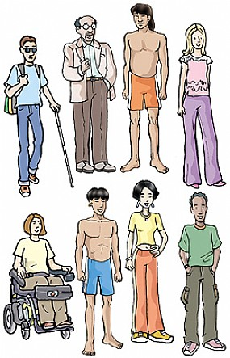
People out of society, society out of transformation

Slide 13
Reductionist tautologies
Nationalism – Global inside Europe?
Targeting the weak – including the isolated members of dominant classes - is not what abolitionism denounces as wrong doing?
Searching for causes at structural or individual levels is misleading

Slide 14
Conceptual tautologies
Crime – refers to questionable behaviors that need to be pointed out and confirmed by the courts
Conspiracy – refers to empirical local levels of privileged communication and action that contradict common understanding of what is level of reality

Slide 15
Crime, delusions and discrimination
War metaphor in biology as well as in crime & punishment
Social discrimination becomes acceptable in crime & punishment procedures
Tautological discrimination is explained as the least possible harm
Dual criterion is expected and becomes institutionalised, in criminal system

Slide 16
Conspiracy theory
Conspiracy exists
It is impossible to know what they comprise
Any theory about any conspiracy is not scientific
Although conspiracies exist, there is no theory available to describe what it is
(Communication sciences as conspiracy theory, avoiding organization)

Slide 17
2. Building updated theories Centrifugal science

Slide 18
Evolution of human social nature
Doing
Voice
Being

Slide 19
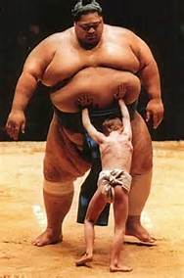
Social struggles at a crossroads
New configurations
call for new theories

Slide 20
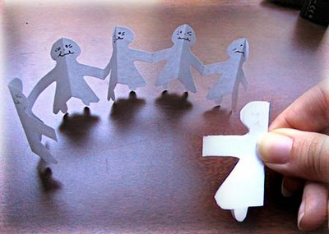
Structural functionalism, media and elitist meritocratic explanation
Politics | Culture
Economy | (modern) Society

Slide 21
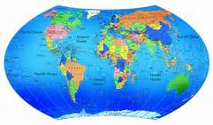
Critique, international relations and modernist explanations
Capitalism | Industrialism
War | Social control (security)

Slide 22
Imaginative futures unite
ABOLICIONIST DEMOCRACY
Soberania
Legitimidade
Interesses diversos,
livres
Juízos morais
Iguais para todos
Níveis de
Realidade
Social
Construídos
CENTRIFUGAL SCIENCE
ANTI-EXTRATIVISM
Corrupção
Dinamismo
Impunidade
Privilégios
TRANSFORMATIVE JUSTICE
Depressão
Esperança
CITIZEN INCOME

Slide 23
3. Social nature and actual society Misogyny, hierarchy and dissimulation

Slide 24
Differentiation & discrimination
Are we born equal and become different, by evolution?
Are we born different and become equal, by moralization?
Markets produce equality or discrimination?

Slide 25
Organization
Empire is a form of ensuring vital functions
Axial Revolution was its birth
Organization its slogan
Sacrifice and slavery for workers
Political economy goal: work, safety and respect for workers
Modern split between work and torture

Slide 26
Revenge
Animals attack and abandon handicapped or ill ones, as a survival instinct
So do people
People blame the victim
Identifying heroes, gifts to gods, Inquisition fires, all are rituals that try to spare people from natural risks using scape goats

Slide 27
Law anthropology
Jubilee as harm reduction provisions
Amnesty; prison reform: modern jubilees
Popular movements: call for jubilee
Hobbesian human nature and Rousseauian popular counterpart
EU crises, PIGS and the call for financial and political jubilee to free economic growth

Slide 28
Anti imperial cultures
Spartacus and Christian ideology
Bourgeois revolutionary gaze
Proletarian counterpart
Modern party invention by Lenin
What is new about Arab Spring, Indignados or Occupy?
Bastille and freeing the prisoners
Gulag and Cold War

Slide 29
Imperial culture
Organizational superiority (violence and ideology)
Modern organization denies violence
Denies jubilee need (as prison harm)
Translates anti-imperial culture into renewed imperial ideology
Each person controlled by bio politics (Rousseau, Weber, Kafka)

Slide 30
4. Centrifugal science

Slide 31
Imaginative futures unite
ABOLICIONIST DEMOCRACY
Soberania
Legitimidade
Interesses diversos,
livres
Juízos morais
Iguais para todos
Níveis de
Realidade
Social
Construídos
CENTRIFUGAL SCIENCE
ANTI-EXTRATIVISM
Corrupção
Dinamismo
Impunidade
Privilégios
TRANSFORMATIVE JUSTICE
Depressão
Esperança
CITIZEN INCOME

Slide 32
The End
http://iscte.pt/~apad
http://iscte.pt/~apad/estesp
http://iscte.pt/~apad/estesp/trilogia.htm

Slide 33
Law anthropology
Takes all times experience of human kind, not only modernization
So, it is able to look at all work done by anti imperial culture as humanitarian ideal
It is able to find hierarchy as result of revenge organization dialectics
Poor people are not scape goats: isolated people are. Poor as much as rich or military or unionists or politicians (Turkey).

Slide 34
Political economy and crime
Dual status facing property of the means of production
Dual status facing the government
Compares with:
Dual status facing the criminal justice
Dual status of emotions facing individuals and society
Cooperation versus stigmatization
as hierarchical procedures

