Slide 1
Social Theory Crisis and State Kidnapping
António Pedro Dores
March, 17th 2016

Slide 2
Table of content
Prison (kidnapping): is it a cultural or an ontological institution?
Organization and Axial Revolution
Divide to rule (inequality criteria instead of stressing equality)
Social theory: embodied disposition and information
Misogynous, elitist and dissimulated society

Slide 3
Kidnapping
Kid-napping – reproduction need
Kidnapping – non incestuous reproduction
Control over women and social identity
Hierarchical organization over violence
Superiority of violent organization (Axial Revolution)
Loyalty threat

Slide 4
Evolution and culture
Symbolic violence
Organization over violence and ideology (justification)
Modernity as multiplication of institutionalization
Civilization process and war
Social theory and violence (studying inequality or equality?)

Slide 5
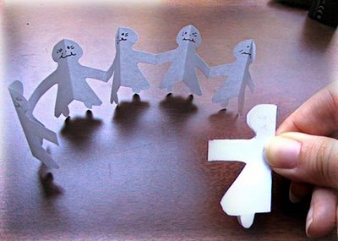
Polítics | Culture
Economy | (modern) Society
Structural funcionalism and media info

Slide 6
Giddens´ critique, internacional relations
Capitalism | Industrialism
War | Social control (security)

Slide 7
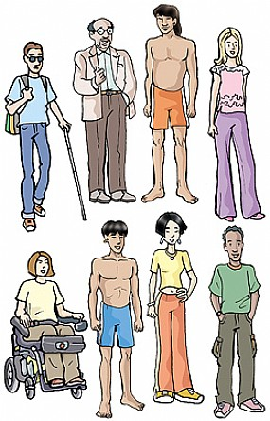
People out of society

Slide 8
Human social nature
Doing
Voice
Being

Slide 9
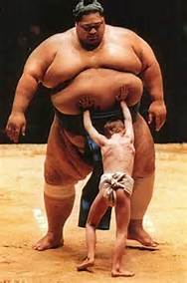
Social struggles

Slide 10
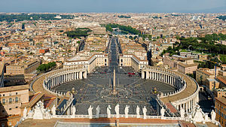
Hierarchy
Female
Male

Slide 11
Centripetal paradigm
Doutrina
Política
IMPERIALISTAS
Economia
Superioridade
Direito
Orgulho
IDEALISTAS
ESTRUTURALISTAS
Níveis de
Realidade
Social
Construídos
INSTITUCIONALISTAS
Bem-estar
Vergonha
Justiça
Medo
Quotidiano
Justiça social

Slide 12
Centrifugal theories
ESTADOS DE ESPÍRITO
Soberania
Legitimidade
Interesses diversos,
livres
Juízos morais
Iguais para todos
Níveis de
Realidade
Social
Construídos
VIOLÊNCIA
TRANSPARÊNCIA
Corrupção
Dinamismo
Impunidade
Privilégios
Depressão
Esperança
COMUNS
Notes:
Stiglitz, J.E., Sen, A. & Fitoussi, J.-P., 2009. Measurement of Economic Performance and Social Progress, Paris.

Slide 13
Analytic focus
POWER
Doing
Voice
HEALTH
IDENTITY
Being

Slide 14
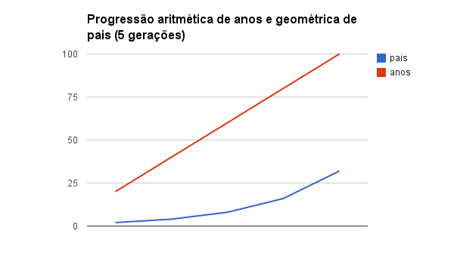

Slide 15
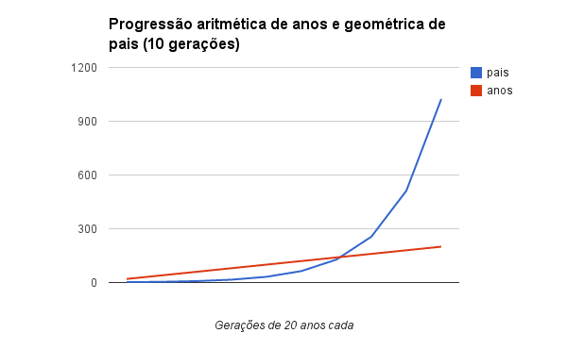

Slide 16
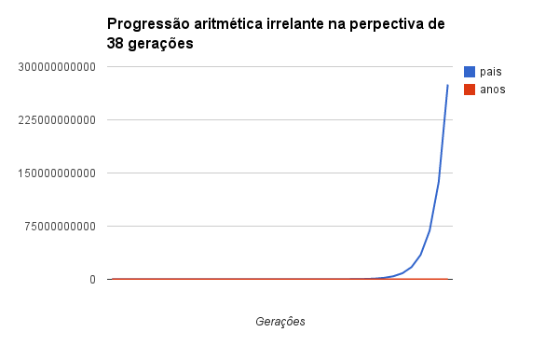

Slide 17
Reality shock
Social services as controling services
Social exclusion is socially produced and managed
State develops and uses legitime ilegal violence

Slide 18
Solidarity does not avoid strutural violence
Chidren ill treatments
Women ill treatments
Foreigner ill treatments
Tolerant subordination of foreigner descendents
Foreigner includes illegitimate children
Scapegout function stretchs hierarchy
Notes:
Zizek diz que ou a esquerda para a entrada de refugiados ou deixa-se dominar politicamente pela extrema direita
http://www1.folha.uol.com.br/mundo/2015/11/1704273-militarizacao-e-solucao-para-crise-dos-refugiados-diz-filosofo-slavoj-zizek.shtml

Slide 19
Conclusion
Social theory built around Social State shorten its own views to avoid structural and ontological ill treatments, as if it were only a matter of “security”, out of society
To survive the conjuncture, social theory should open itself to reality: social human nature and its uses by modern societies.

Slide 20
End
http://iscte.pt/~apad
http://iscte.pt/~apad/estesp/trilogia.htm

