Slide 1
The emotional face and the sociology of instability
1st World Congress on Facial Expression of Emotion
António Pedro Dores (Oct. 2014)

Slide 2
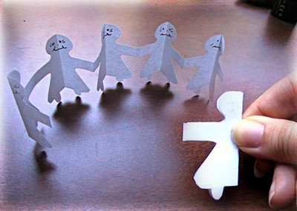
No faces in society

Slide 3
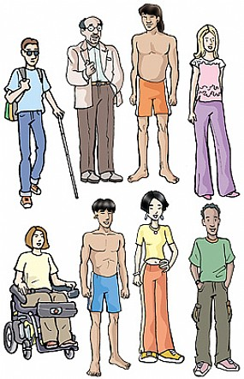
Faces out of society

Slide 4
WHAT FOR
DO ONE NEED SOCIOLOGY HERE?

Slide 5
Argument
There is a problem with social sciences disciplines: they do not communicate to each other (and beyond)
The problem´s name: centripetal policy
There is the time to reverse it – we need centrifugal sciences policies

Slide 6
Two parts
I - What are sciences useful for?
II – A sociological contribution for
conceptualization of emotion

Slide 7
Cartesian social utopia
deity - norms
God´s face
faces down
Political face
faces down
society
Communities' faces
face up
People´s multiple faces
face up
psycho-biology

Slide 8
Is there society at all?
“There is no such thing as society!”
Mrs. Thatcher
What is the use of sociology (and humanities, and social sciences)?
Is not it economics enough to explain how weak forces emerges with strength? selfmade people
Notes:
Consumption and financial decisions drive weak decisions in strong effects, such as election can do as well

Slide 9
Social sciences division
Political science – International relations
Socio-economics
Psychology – techno-sciences

Slide 10
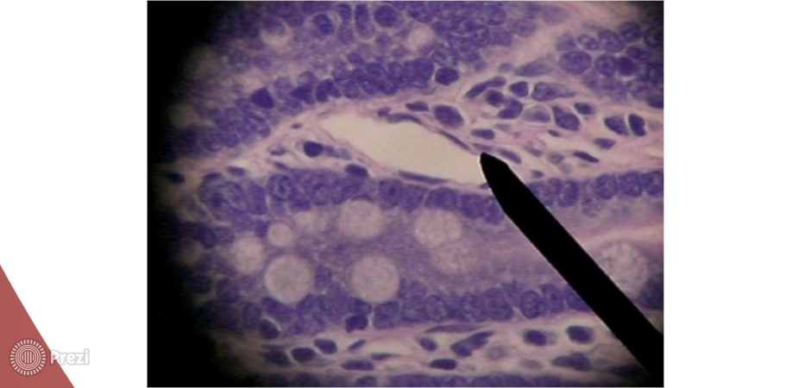
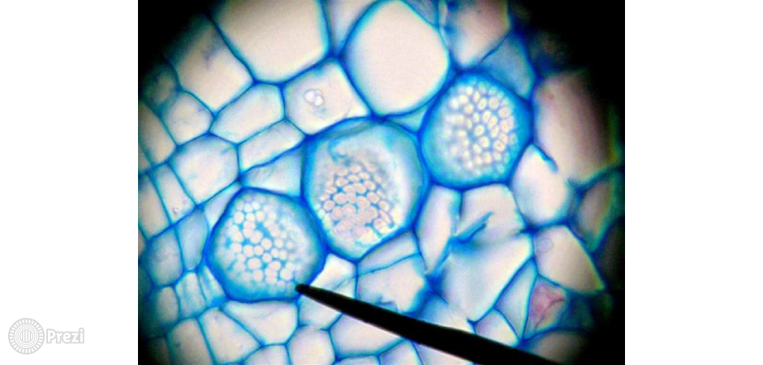
Damasio´s critique to Descartes
The thinking habit of
conceive unity on
tissues should be
compatible with the
autonomy of cells

Slide 11
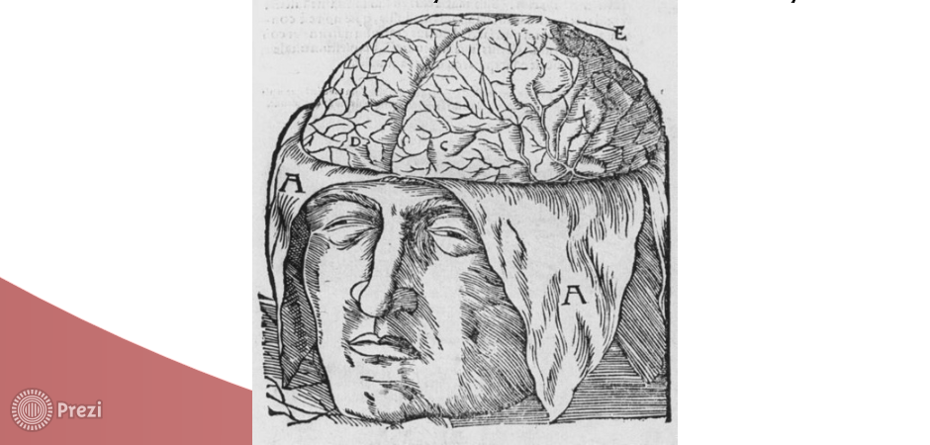
Social critique to biology
Tissues and organs struggle for life
as much as societies do.
“O povo unido jamais será vencido”
“United, no one ever defeat us”
Difficult it is, life depends on unity.
Still, one lives. How it happens?
Notes:
INERTIA – SOCIAL ORDER – BORDIEU
Background for evolution

Slide 12
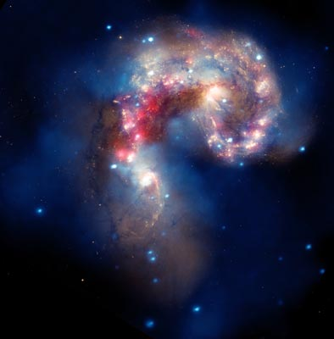
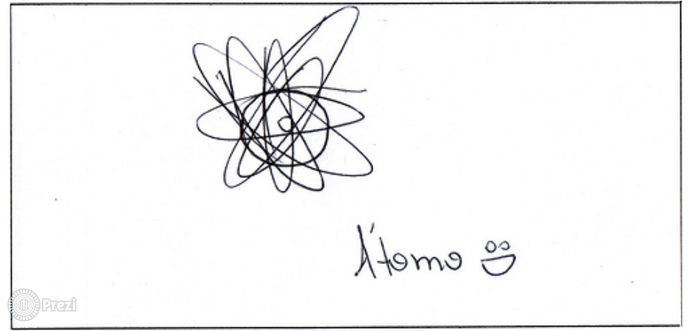
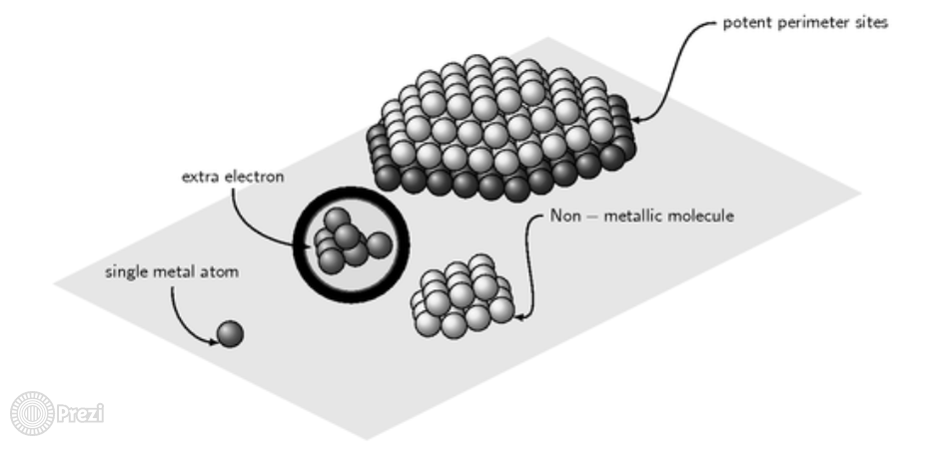
Societies of matter
Instable non living
societal organizations
of matter (cybernetics;
artificial intelligence )
Be it micro, meso or
cosmic dimensions
(weak are strong)
Notes:
Weak atoms can be broken. They release inertia strength
Strong nebulae can be traced and travelled deep inside without much danger

Slide 13
What is social instability?
1st (weak) individual consciousness of instability desires (strong) social stability
2nd much weak energy is spent to avoid instability, both by bodies and societies
3rd saving self energy can spend a lot of bond´s energy (from society, slaves, nature)
4th to deal with instability is a evolutionary social challenge (resources; war; global warming)

Slide 14
What do we need?
Weak and strong energy from cosmos:
strong inspiration (science as wisdom) – to protect us from centripetal policies;
weak efforts – to claim from out of the human sphere ecologically healthy energy to organize life better.
We need centrifugal sciences to produce moral-ecological energies for life on Earth.

Slide 15
Out of centripetal policy
Along with hipper specialization draw by state-corporate labeling interests, one need to develop a transversal treadmill across sciences and humanities for social sciences survival sake
That is the time for centrifugal sciences and crossing concepts (such as weak and strong forces: emotions and bonds)

Slide 16
Sciences | Centrifugal concepts | Social sciences
Weak force (inside atoms) | Emotions (secret and changing forces) | Agents
Strong force (matter centrifuging) | Bonds (power and conservative forces) | Structures

Slide 17
II Part Social sciences contributions
Thomas Scheff definition of social emotion:
Bodies feel deep inside threatens to the social bonds
Bodies produce shame emotions to deal with social threats to their social bonds
Notes:
How bodies feel threatens? Mimesis and recursively
Emotions supports agency and do sign society about the existence of treats

Slide 18
Enlargement of the concept
Societies | Pre-modern | Modern
Main emotion | Fear | Shame
Definition | Risk for life (body reproduction) | Risk for social bond (status)

Slide 19
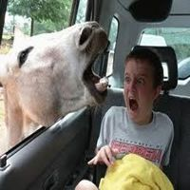
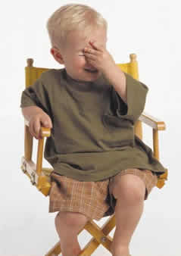
Emotions signal the needed for social change
Freezing individual fear
Freezing individual shame

Slide 20
Modes of behavior: violent and civilized
Capitalism | Industrialism
War | Social Control (security)
Physical Action
Fear
Politics | Culture
Economics | Society
Communi-cation
Shame

Slide 21
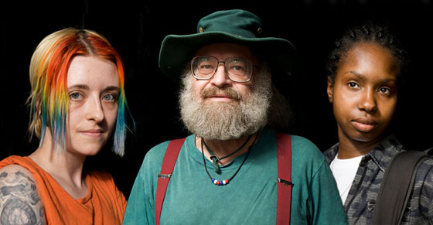
Social discrimination against social instability
Who is struggling for life?
Who cannot communicate?

Slide 22
The nature of human sociability
Done
Said
Shame
Fear
of breaking the law
of social isolation
Being
Well being
shame and fear of bad shape (death)

Slide 23
Sociology of instability
Different social situations claim for different faces on the same person (weak characters)
Historical situations claim for different faces of the same society (strong norms)
Conservation of humanity claim for change of society bonds and levels of energy consumption

Slide 24
The end
http://iscte.pt/~apad
http://iscte.pt/~apad/estesp
http://prezi.com/nquya3t7_bwf/espirito-e-sociedade

Slide 25
Dinâmicas Sociais e Modernização
ciclo de solidariedade
ciclo emancipatório
racionalização
racionalização
reclamação direitos
reclamação direitos
Controlo
Exclusão
fechamento
fechamento
criminalização
criminalização
revolução
revolução
institucionalização
institucionalização
Justiça social

